Slide 1

Class-Based-Views
Create Views Without Having to Write Too Much Code
Class
SoftUni Team
Technical Trainers
Software University
https://softuni.org

Slide 2
Table of Contents
What are Class-Based Views?
Base Views
Generic Views
Useful CBVs Methods
2
Notes:
2

Slide 3
Have a Question?
sli.do
#python-web
Notes:
3

Slide 4

What are Class-Based Views?
CBV

Slide 5
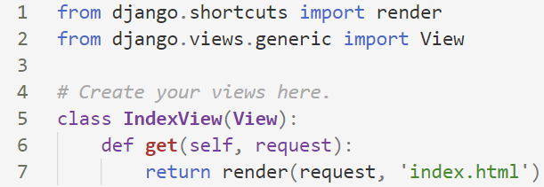
What are CBV's?
A view is a callable which takes a request and returns a response
Class-based views provide an alternative way to implement views as Python objects instead of functions

Slide 6
CBV's Inheritance Structure
Class-Based-Views use class inheritance
They also use the "mixin" pattern
You can create classes with related functionality
You can include that class as parent of another class

Slide 7
CBV vs. FBV - Pros
Class-Based Views
Easily extended
Can use techniques like mixins
Handling HTTP methods in separate class methods
Built-in generic CBV's
Function-Based Views
Simple to implement
Easy to read
Explicit code flow
Straightforward usage of decorators

Slide 8
CBV vs. FBV - Cons
Class-Based Views
Harder to read
Implicit code flow
Hidden code in parent classes, mixins
Use of decorators require extra import
Function-Based Views
Hard to extend
Hard to reuse
Handling HTTP methods via conditional branching

Slide 9

Base Views

Slide 10
Base Views
"Parent" views, which can be used by themselves or inherited from
Provide much of the functionality needed to create Django views
However, they may not provide all the capabilities required for projects
They are positioned in the base.py module

Slide 11
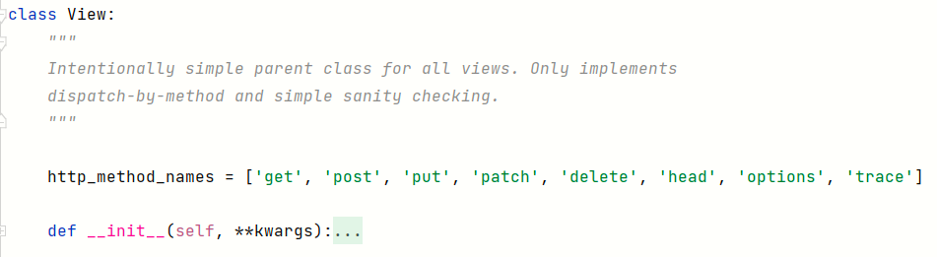
The View Class
The master class-based base view
All other class-based views inherit from it
HTTP method names that this view accept
['get', 'post', 'put', 'patch', 'delete', 'head', 'options', 'trace']

Slide 12
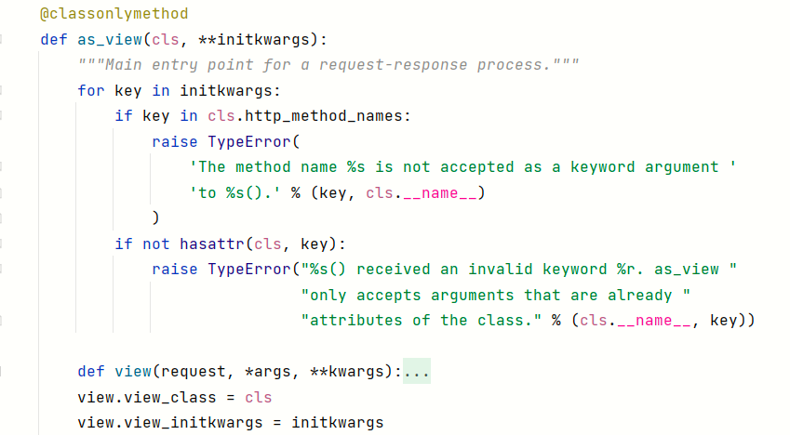
The as_view method
It is decorated by a @classonlymethod
Meaning it is only available on the class and not on an instance
It iterates over initkwargs and makes validations

Slide 13
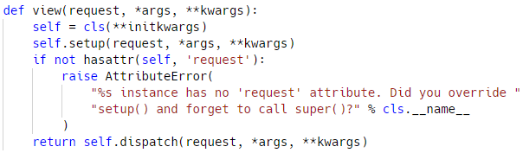
The view method
It accepts request, *args, **kwargs
It binds
self to the class attributes **initkwargs
self.request = request
self.args = args
self.kwargs = kwargs
Creating a function that wraps around an instance of our class, and executes dispatch() on that instance

Slide 14
The TemplateView Class
A template view renders a given template, with the context containing parameters captured in the URL
It inherits methods and attributes from the following
TemplateResponseMixin
ContextMixin
View

Slide 15
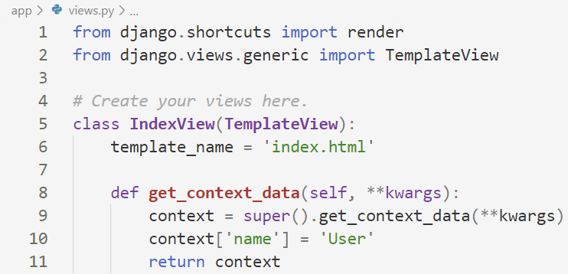
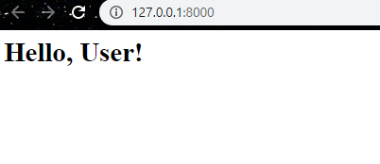
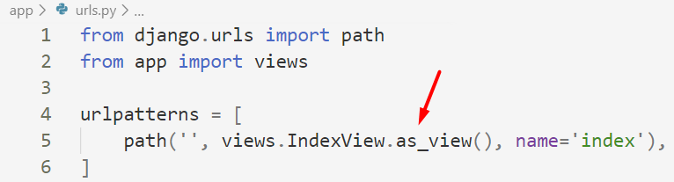
Basic Template View Example

Slide 16
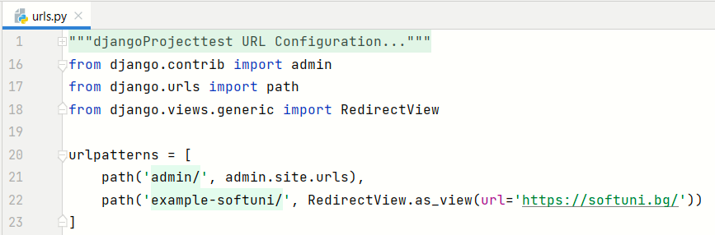
The RedirectView Class
Redirects to a given URL
It inherits from the View class only

Slide 17

Generic Views

Slide 18
Built-in Generic Views
Ease the monotonous development process
Provide interfaces to perform the most common tasks developers encounter
Generic views:
Display list and detail pages for a single object
Allow users to create, update, and delete objects
Present date-based objects in year/month/day archive pages

Slide 19
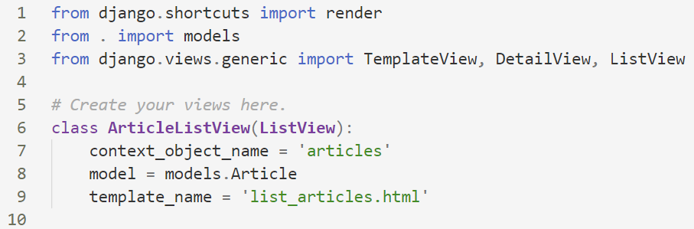
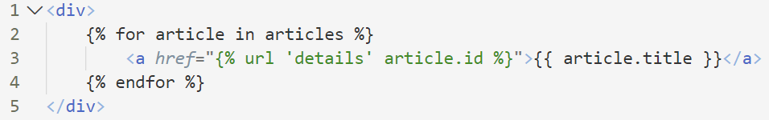
Basic List View Example
A list view is used for representing a list of objects

Slide 20
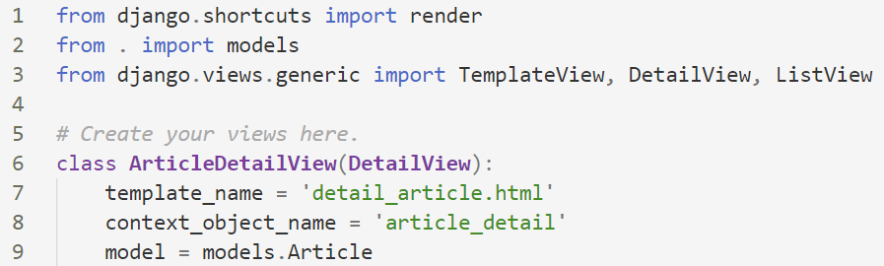
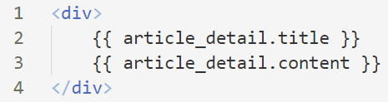
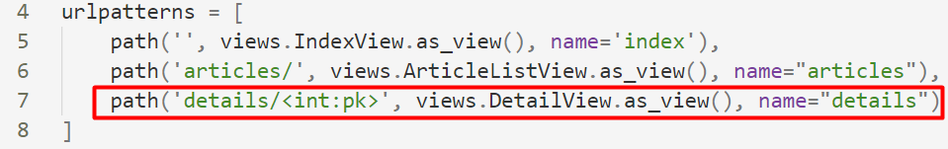
Basic Detail View Example
While this view is executing, self.object will contain the object that the view is operating upon

Slide 21
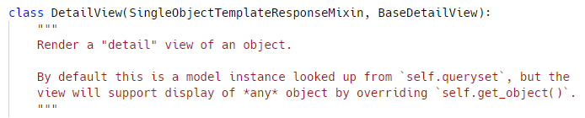
DetailView inheritance structure
The DetailView is defined in django/views/generic/details.py file
We see here that DetailView doesn't define anything
It inherits from SingleObjectTemplateResponseMixin and BaseDetailView

Slide 22
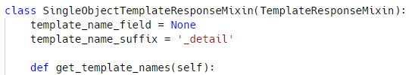
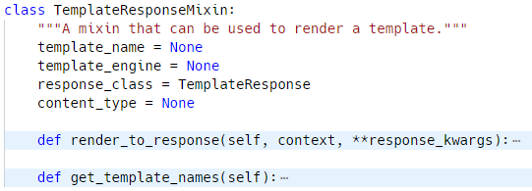
CBV's inheritance structure
Scrolling up in the same file, we can inspect the SingleObjectTemplateResponseMixin
It inherits from TempleteResponseMixin

Slide 23
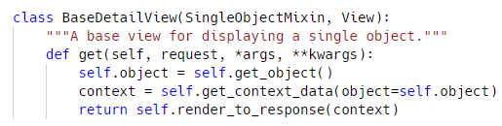

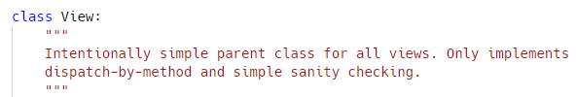
CBV's inheritance structure
Going a step back, it is now time to check out the BaseDetailView, and it inherits from two things
SingleObjectMixin
View

Slide 24
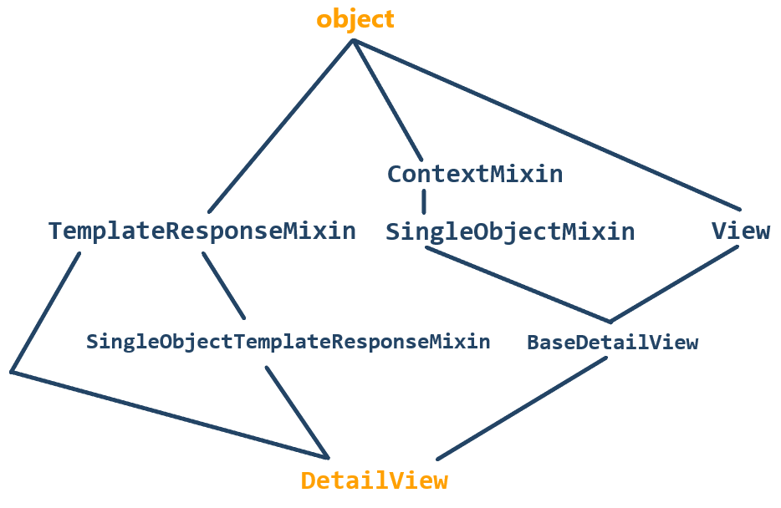
CBV's inheritance structure
Finally, we find that ContextMixin, TemplateResponseMixin and View all inherit from object

Slide 25
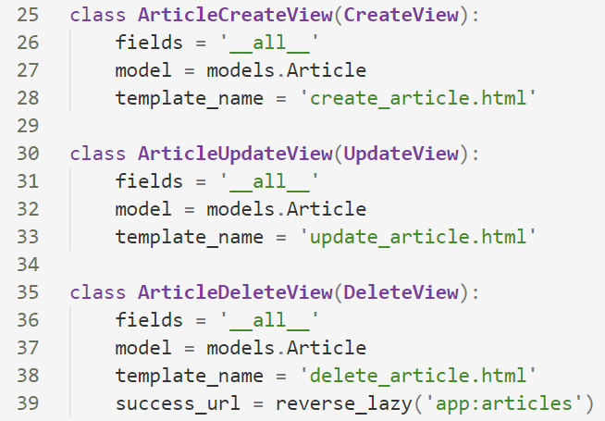
CRUD Views
A Create view displays a form for creating an object
An Update view displays a form for editing an existing object
A Delete view displays a confirmation page and deletes an existing object
Action on success

Slide 26
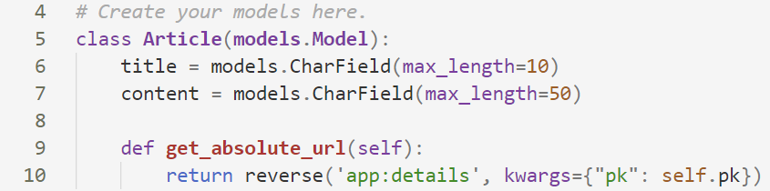
Set up absolute URL
When using a CreateView, we need to use a function in the model called get_absolute_url()
We use it to tell Django how to calculate the canonical URL for an object
Renders the details view after creation

Slide 27

Useful CBVs Methods
CBV

Slide 28
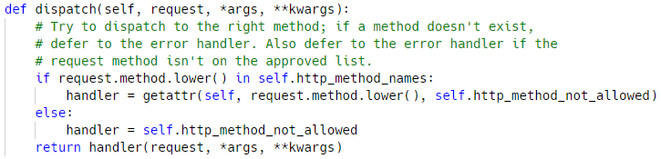
CBV dispatch()
The view part of the view – the method that accepts a request, *args, **kwargs, and returns an HTTP response
It inspects the HTTP method and attempt to delegate to a method that matches the HTTP method

Slide 29
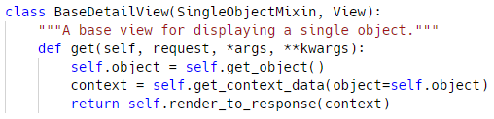
CBV dispatch()
get() accepts the request, *args, **kwargs
It binds self.object to self.get_object
It binds context to self.get_context_data
It returns self.render_to_response(context)
The get_object() method is found in the SingleObjectMixin class

Slide 30
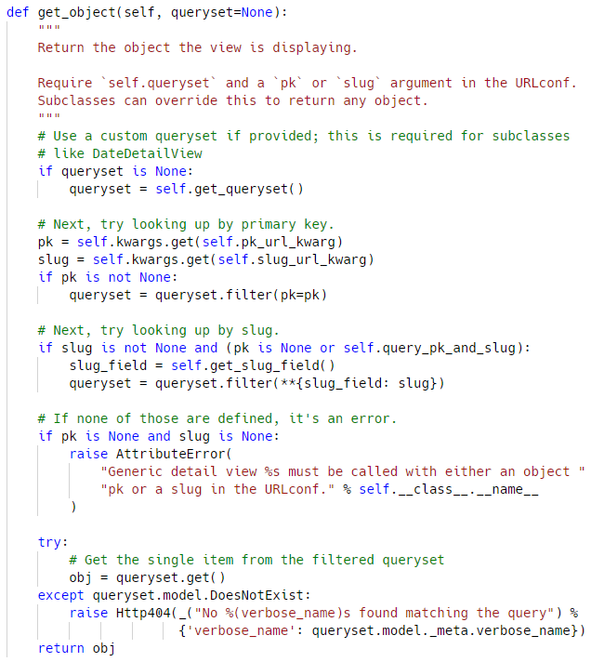
The get_object method
It is method from the SingleObjectMixin class
Returns a single object that the view will display
If queryset is provided, that queryset will be used as the source of objects
Performs a primary-key based lookup using the pk argument from the URL path

Slide 31
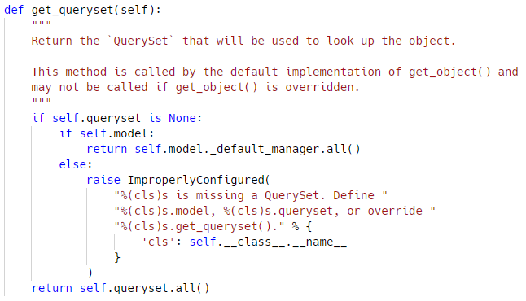
The get_queryset method
Returns the queryset that will be used to retrieve the object that the view will display
If it is not set, it constructs a QuerySet by calling the all() method on the model attribute’s default manager
Otherwise, if you don't have a model or queryset then an ImproperlyConfigured error is thrown that says "we have no idea what you are looking for"

Slide 32
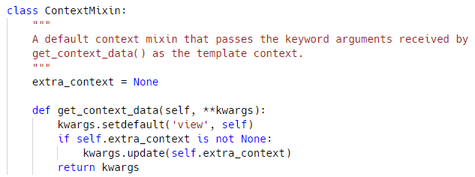
The get_context_data()
Returns a dictionary representing the template context
The keyword arguments provided will make up the returned context
When overriding this method, you should call the super method for the .get_context_data(**kwargs)

Slide 33
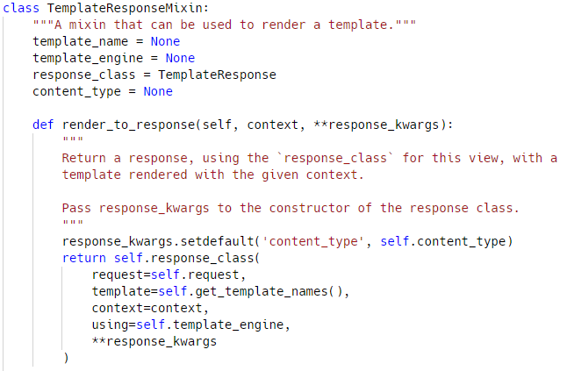
The render_to_response()
Returns a self.response_class instance
If any keyword arguments are provided, they will be passed to the constructor of the response class
Calls get_template_names() to obtain the list of template names that will be searched looking for an existent template

Slide 34
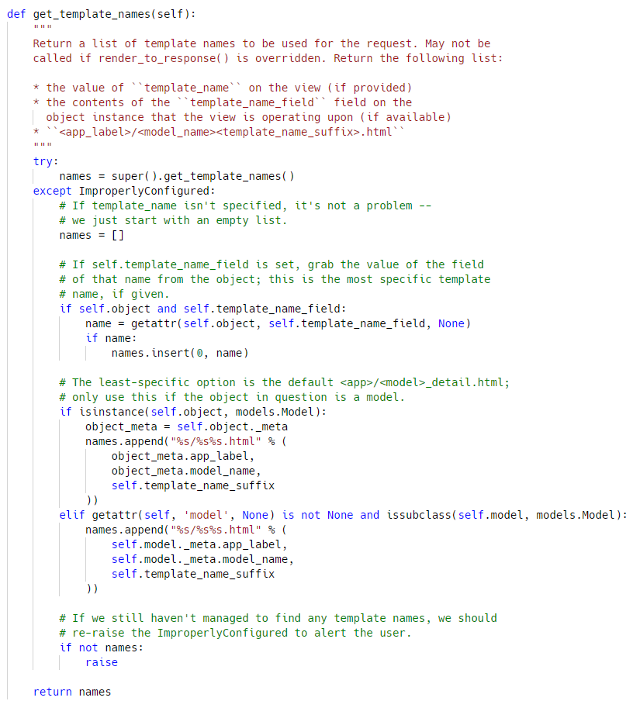
The get_template_names() method
Returns a list of template names to search for when rendering the template
The first template that is found will be used
The default implementation will return a list containing template_name (if it is specified)

Slide 35

Practice Time
Using Class-Based-Views

Slide 36

Summary
Class-based views provide an alternative way to implement views as Python objects instead of functions
CBV's are easily extended, as function views are easier to implement
To practice, try redoing your older projects and use CBV's instead of function bases ones
Notes:
36

Slide 37
Questions?
Notes:
37

Slide 38













SoftUni Diamond Partners

Slide 39


Educational Partners

Slide 40

License
This course (slides, examples, demos, exercises, homework, documents, videos and other assets) is copyrighted content
Unauthorized copy, reproduction or use is illegal
© SoftUni – https://softuni.org
© Software University – https://softuni.bg
Notes:
40

Slide 41
Trainings @ Software University (SoftUni)
Software University – High-Quality Education, Profession and Job for Software Developers
softuni.bg, softuni.org
Software University Foundation
softuni.foundation
Software University @ Facebook
facebook.com/SoftwareUniversity
Software University Forums
forum.softuni.bg
Notes:
41

